Slide 1
ASIC implementation of I2C
Submitted to:
Dr. Abdulrahman Qotb
Eng. Amira Elhamshary
Submitted by:
Fagr Ahmed Abd Elrazek “AUC section 12” ID:V23010586
Marwa Moaz “AUC section 14” ID:V23009897
Mohamed Yasser “AUC section 16” ID:V23010495
shurooq Mohammad Hassan Alshal “AUC section 12” ID:V23010529

Slide 2
Agenda
Introduction
Synthesis
Formality
Pnr

Slide 3
Introduction

Slide 4
Introduction
ASIC flow of I2C protocol
Constraints file was created according to specs
Synthesis of the project to produce gate level netlist
The complete ASIC flow to produce GDS file
Formality check between pre and post synthesis netlist
Check timing and no violations were reported

Slide 5
Synthesis

Slide 6
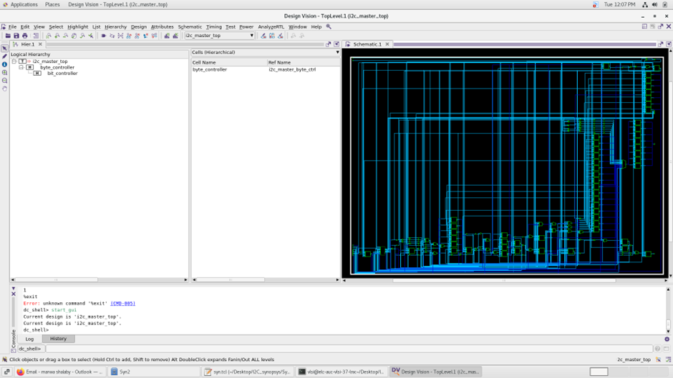
Synthesis
Read the RTL design
Read the constraints file
Determine the needed libraries
Compile the design to produce gate-level netlist
No timing violations were reported

Slide 7
Formality

Slide 8
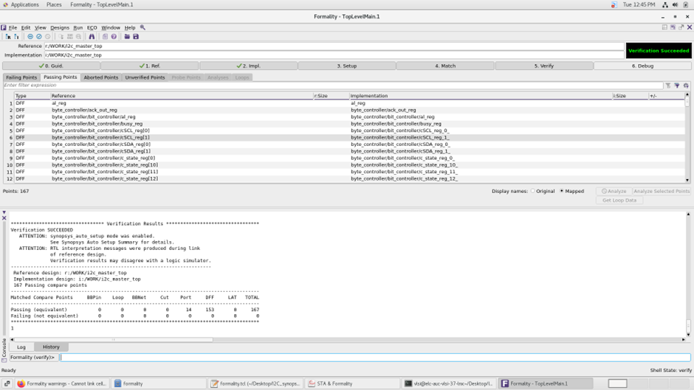
Formality
Compare pre and post synthesis netlists to verify same functionality
Formality succeeded with no violations

Slide 9
PNR

Slide 10
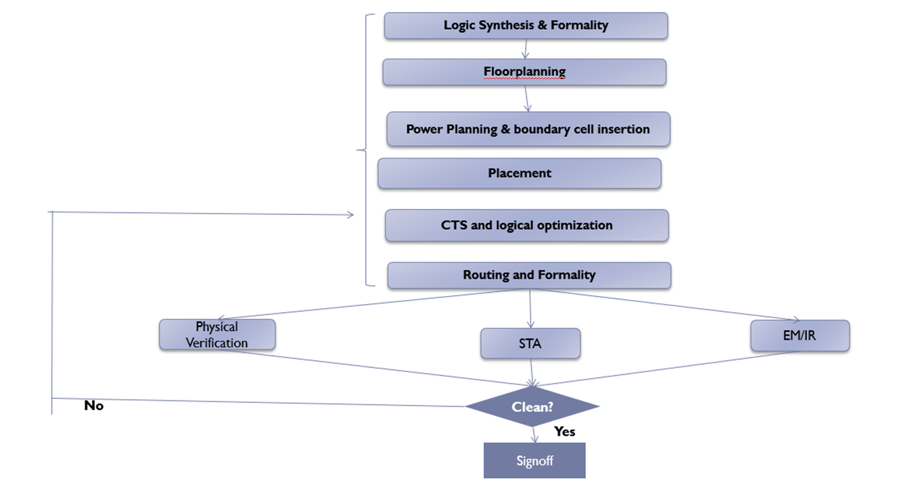
PNR

Slide 11
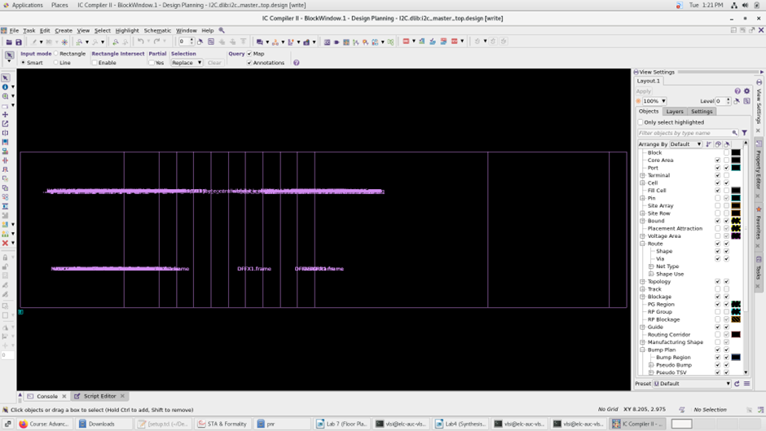
Initial floorplan

Slide 12
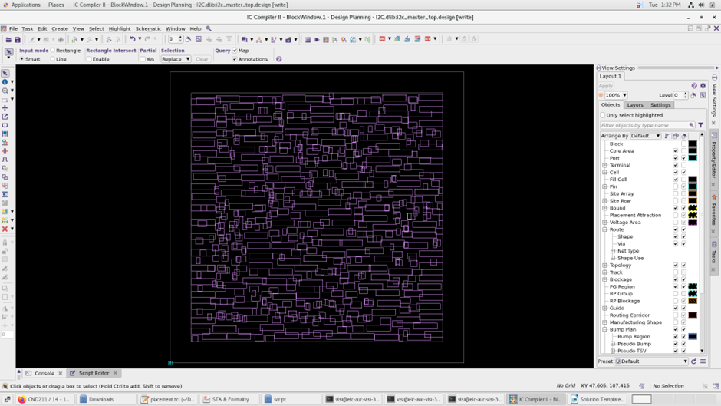
Floorplan without pins placement

Slide 13
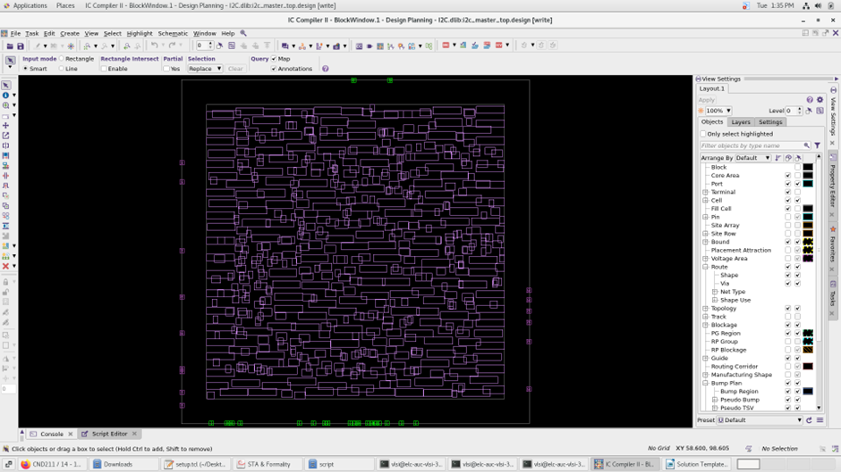
Floorplan with pins placement

Slide 14
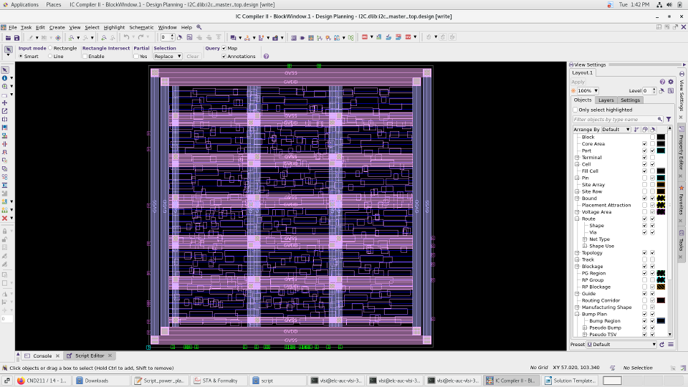
Power planning

Slide 15
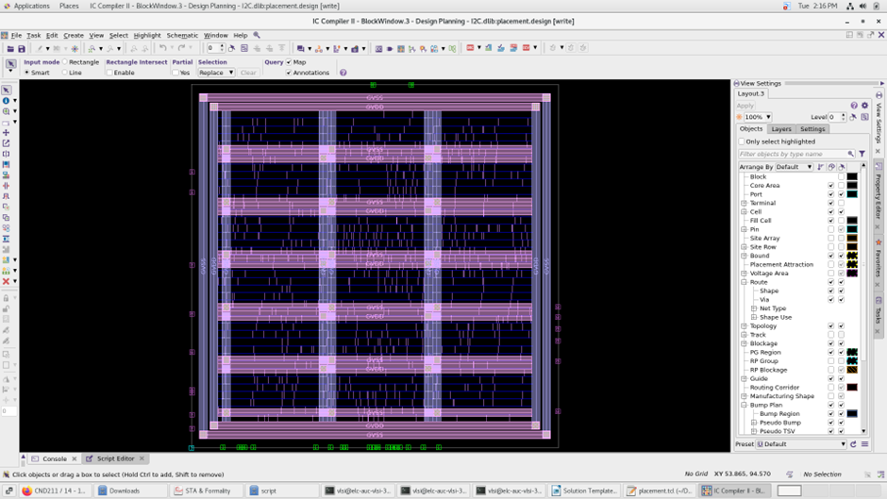
Placement

Slide 16
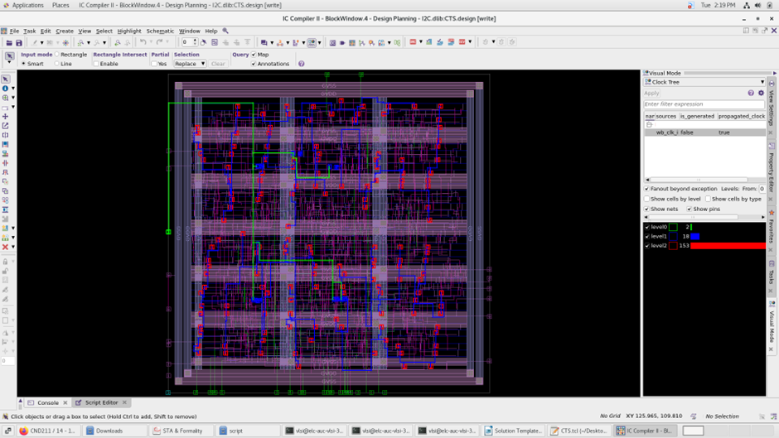
CTS

Slide 17
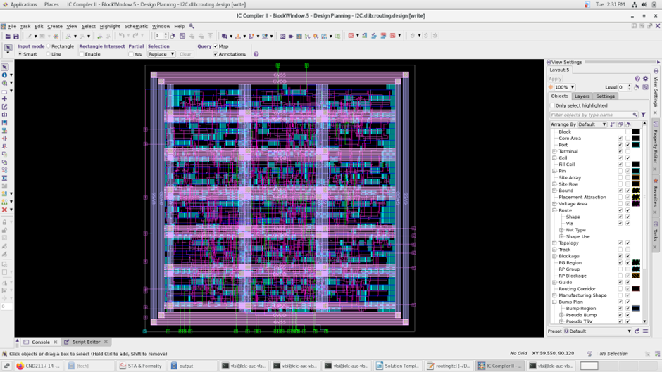
Routing and signoff

Slide 18
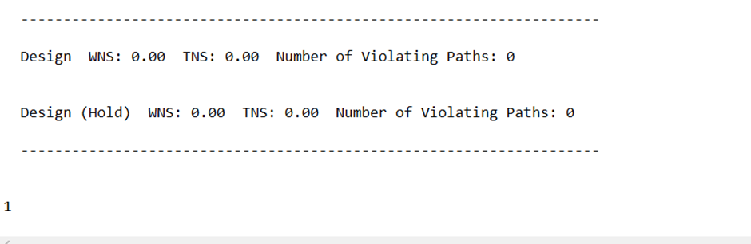
Timing passed

